Slide 1
Understanding learners in transition
Andy Noyes – University of Nottingham
2nd March 2012

Slide 2
14-19 transitions in mathematics
Two projects:
ESRC Geographies of Mathematical Attainment and Participation (2007-10)
QCA Evaluating Mathematics Pathways (2007-10)

Slide 3
Key Issues 1 – the social
Patterns of participation in A level, e.g.
Social class
Least deprived quintile over four times more likely to get A*/A
Ethnicity
Chinese/Asian vs British
Gender
Girls less likely to choose A level, all other things being equal; difference greater with lower GCSE grades
Cultural/Social attitudes to mathematical progression;
exchange value
relevance
delayed gratification (cultured values)

Slide 4
Example...
Estimated probability of completing some AS/2 maths (girls, GCSE grade A)
White British 0.42
Bangladeshi 0.64
Pakistani 0.65
Indian 0.69
African 0.73
Chinese 0.75

Slide 5
Key Issues 2 – Curriculum
Curriculum
Reforming curriculum is problematic
Algebra as threshold concept; assessment (and mark schemes) weak to elicit and reward algebra
Mathematics and Use of Mathematics
Pathways
Are current qualifications sufficient?
Schools already have pathways
Transition at 16 problematic
Performativity all-pervasive

Slide 6
Key Issues 4 - school
Schools matter
Big differences in uptake between classes/teachers
Classroom culture is important
11-16 ‘value added’ variable between schools
MLM suggest 20% unexplained variance in AS/2 completion at school level

Slide 7
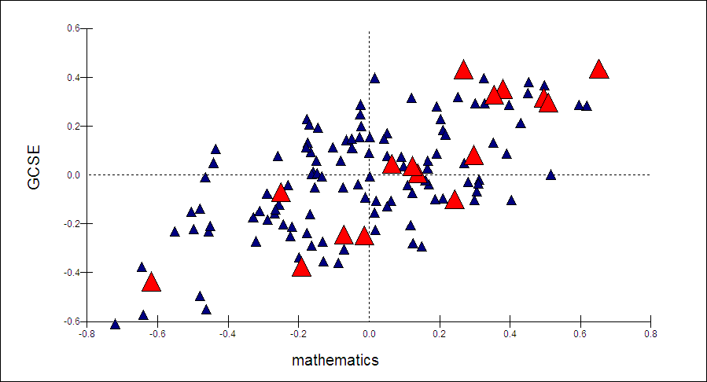
Pairwise plot of school level residuals (East Midlands) for KS2-4 CVA in maths and combined other subjects (GCSE).

Slide 8
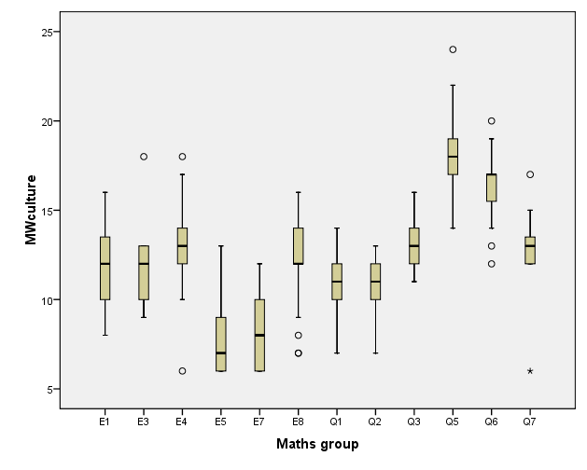
Maths classroom culture
The top mathematics groups (expecting A*/A grades) are E5/7 and Q5 respectively
In E5 and E7 about 70% and 80% respectively are considering A level mathematics whereas in Q5 the figure is a drastically reduced 25%.

Slide 9
Key Issues 3 - Policy
Politics/Policy and Reform
Multiple interests
Complex demands
The scales of time
Limited policy analyses of mathematics education reform

Slide 10
References
Noyes, A. (2009). Exploring social patterns of participation in university-entrance level mathematics in England Research in Mathematics Education, 11(2), 167-183.
Noyes, A. (2009). Participation in Mathematics: what is the problem? Improving Schools, 12(3), 277-299.
Sealey, P. & Noyes, A. 2010. On the relevance of the mathematics curriculum to young people. The Curriculum Journal, 21, 239-253.
Noyes, A., Drake, P., Wake, G., & Murphy, R. (2010). Evaluating Mathematics Pathways: Final Report, December 2010 (confidential report to QCDA). Nottingham: University of Nottingham. [https://www.education.gov.uk/publications/standard/publicationDetail/Page1/DFE-RR143]
Noyes A. 2011. Reforming 14-19 mathematics education in England: whose quality and equity? In: Atweh, B., Valero, P. & Secada, W. (eds.) Quality and Equity in Mathematics Education. Dordrect: Springer.
Noyes, A. & Sealey, P. (2011) Managing Learning Trajectories: the case of mathematics. Educational Review. 63: 2, 179-193
Noyes, A., Wake, G. and Drake, P. (2011) Widening and increasing post-16 mathematics participation: pathways, pedagogies and politics. International Journal of Mathematics and Science Education, 9:483-501
Noyes, A. (2012, in press) The effective mathematics department: adding value and increasing participation? School Effectiveness and School Improvement
Noyes, A. & Sealey, P. 2012. Investigating participation in Advanced level mathematics: a study of student drop out Research Papers in Education, 27, 123-138.
Noyes, A. Wake,. G, and Drake, P (2012) Education reform and the scales of time: the case of England’s 14-19 mathematics pathways, submitted to the Journal of Educational Policy
Wake, G., Noyes, A. & Drake, P (2012, in preparation) Assessing algebra: do you really get what you test?
Noyes, A. (2012) It matters which class you are in: student-centred teaching and the enjoyment of learning mathematics, resubmitted to Research in Mathematics Education

